Slide 1
Protecting People
on High-Speed Boats
Johan Ullman M.D.
Ullman Dynamics
HSBO Pro

Slide 2
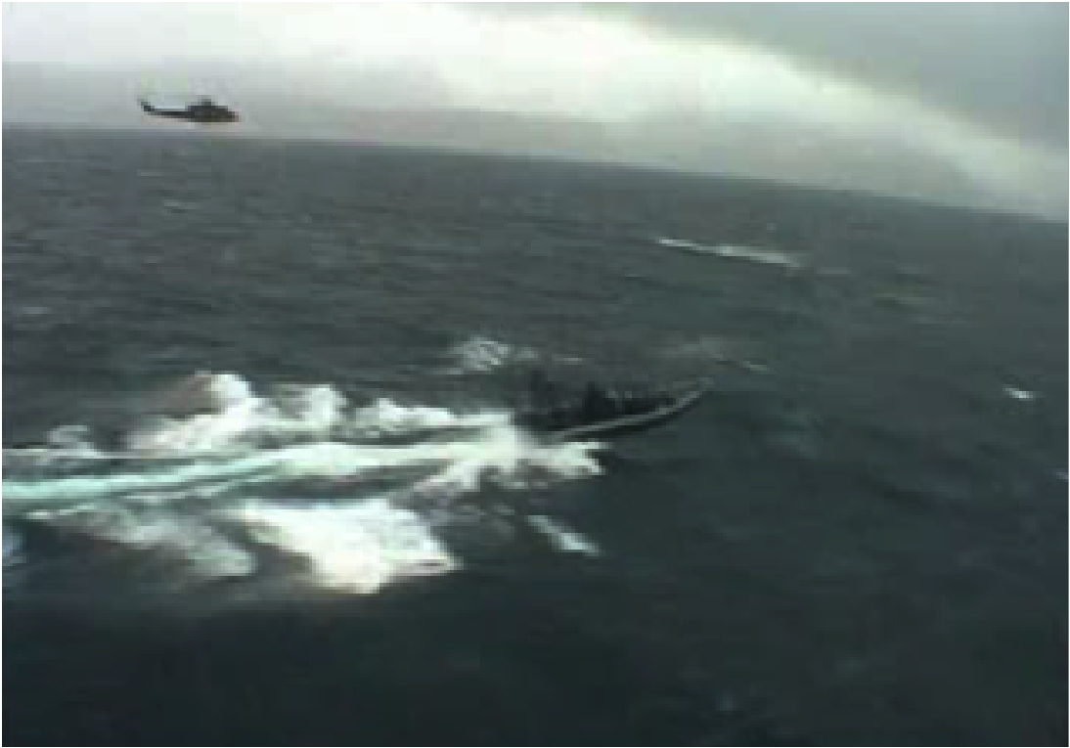
High-Speed Boat Operations
Forum
6-8 May 2014.
www.HSBO.org

Slide 3
High-Speed Boats Operations
are no longer limited by top speed
Sea Keeping
&
Human Factors
set the limits

Slide 4
Human Factors
Biomechanics
Impact Exposure
Physical Fatigue
Injury mechanisms
Suspension Mechanics
Standing vs. Sitting
Shock Mitigation
Legislation in Europe and US
Standards in Europe and US
Intuitive Operator Interfaces
Topics:

Slide 5
EU-Directive on
Whole Body Vibration and Impact
It is the law
EXPERIMENT
It makes the employer responsible
- for impact induced injuries
It sets limits for exposure values
It decrees the use of the proven best available
technologies - to reduce impact exposure
Link for downloading the directive:
http://www.ullmandynamics.com/wp-content/uploads/2010/10/eu_directive_2002_44CE_EN.pdf

Slide 6
Ultimately
Human Factors
WILL
Determine Operational Success

Slide 7
People get fatigued onboard HSB
Fatigue is a risk factor
- at sea
- and in combat
People also get injured onboard HSB
Many people get severe
and permanent injuries

Slide 8
People get fatigued onboard HSB
Fatigue increases the risks for
• Mistakes
• Accidents
• Injuries

Slide 9
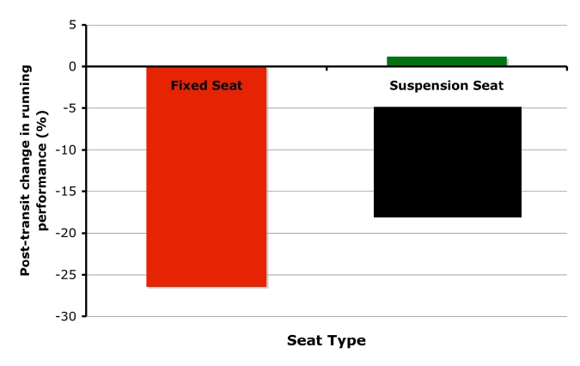
MOTION INDUCED FATIGUE
POST-TRANSIT PERFORMANCE DEGRADATION
26%!
REDUCTION !
in Running
Performance!
1%!
IMPROVEMEN
T !
in Running Performance!

Slide 10
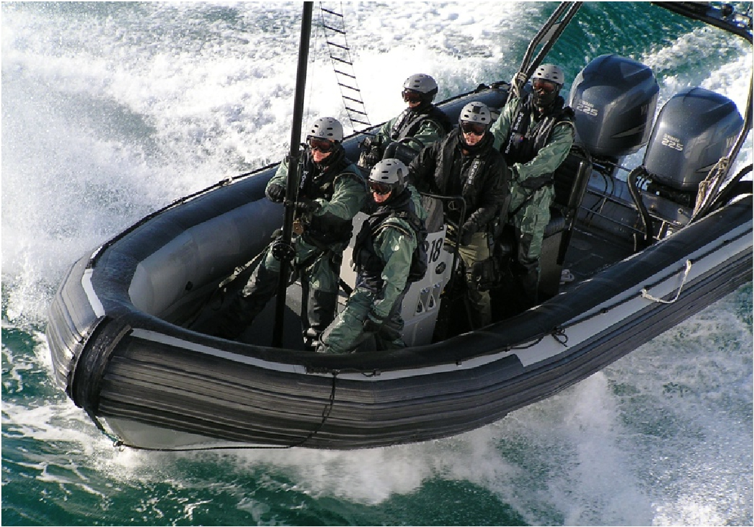

Slide 11
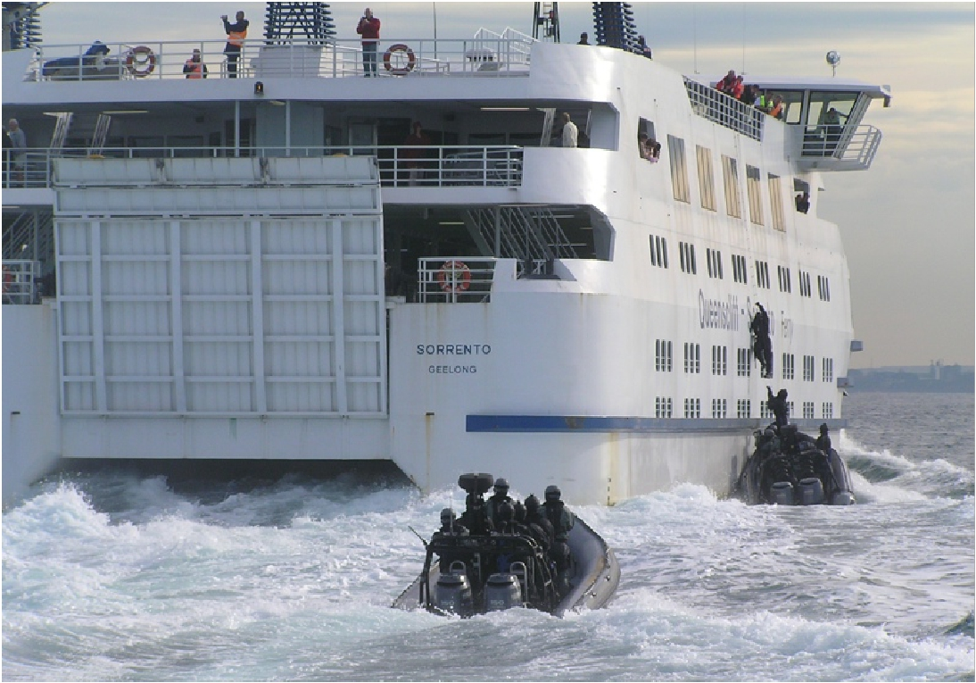

Slide 12
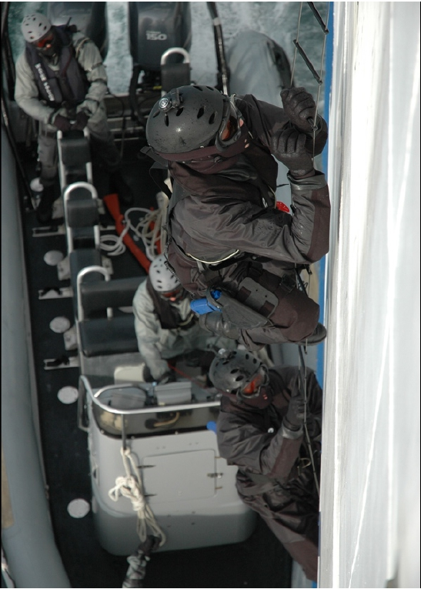
Fatigue is a
risk factor
at sea
and in
Operations

Slide 13
Higher Speeds Increase
Impact Exposure on Crew
Physical Fatigue
Risk of Mistakes
Risk of Injuries

Slide 14
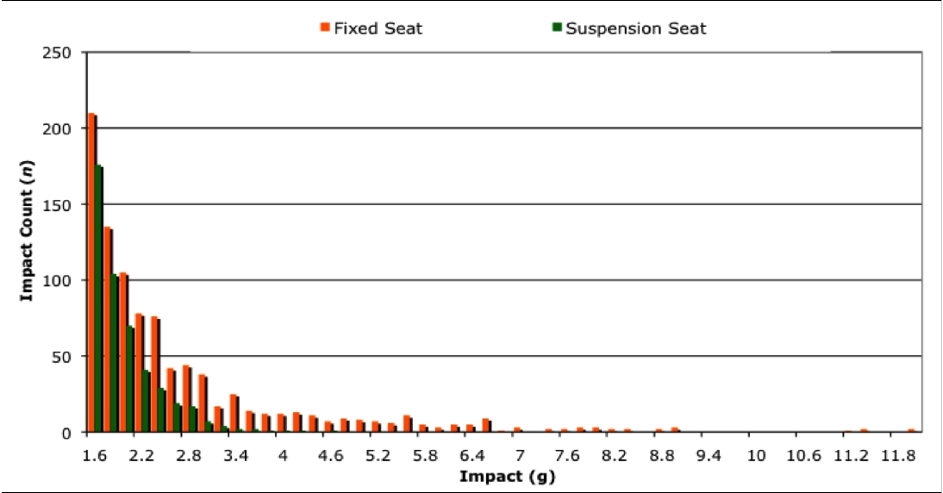
IMPACT COUNT (IC)
Fixed Seats vs. Suspension Seats
State of the Art suspension seats reduced number of impacts by ≈ 50%
and magnitude of impacts by ≈ 50% - compared to the fixed seats

Slide 15
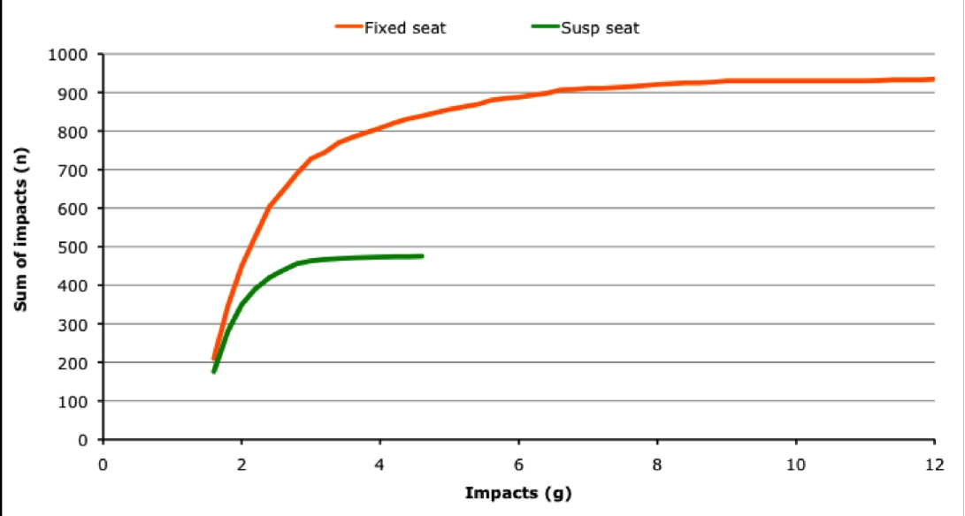
CUMULATIVE IMPACT COUNT (IC)
State of the Art suspension seats reduced number of impacts by ≈ 50%
and magnitude of impacts by ≈ 67% - compared to the fixed seats

Slide 16
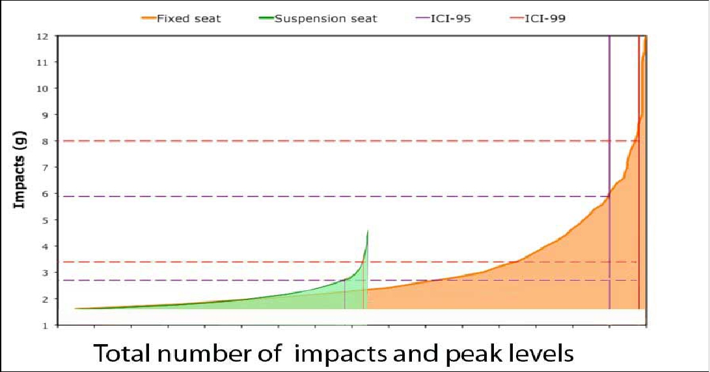
CUMULATIVE IMPACT COUNT (IC)
State of the Art suspension seats reduced number of impacts by ≈ 50%
and magnitude of impacts by ≈ 67% - compared to the fixed seats

Slide 17
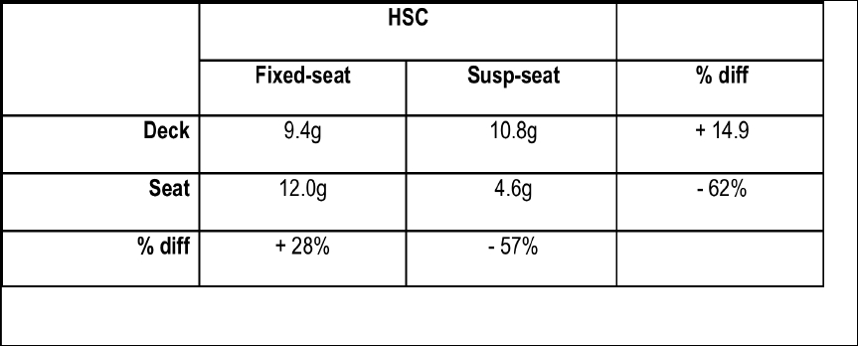
PEAK IMPACTS
The higher the impacts the higher the difference in exposure.
Fixed seats amplify hull impact levels when the reach the spine.

Slide 18
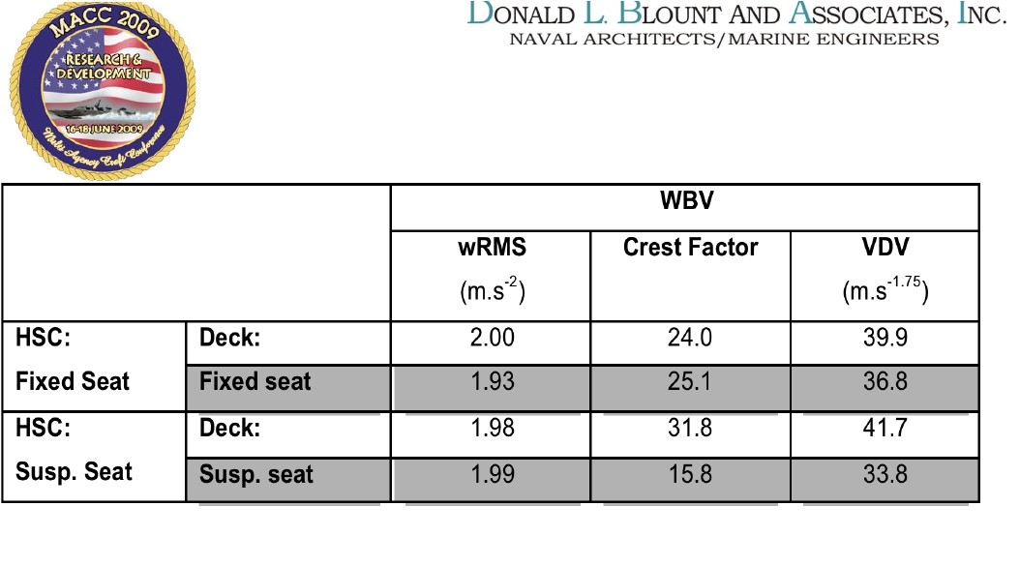

TRADITIONAL WBV MEASURES
Fixed seat vs. suspension seat trial
Measures DON T reflect what occupants feel / report
EU PAD WBV:
RMS – EAV = 0.5 m.s-2,
VDV – EAV = 9.1 m.s1.75,
ELV = 1.15 m.s-2.
ELV = 21 m.s1.75.

Slide 19
Which are the injury risks?
Spine is subject to
•
•
compression forces
shear forces
Lower back: Vertebral fractures, Disk herniations
Neck: Vertebral fractures, Disk herniations,
Distortion injuries, as in Whiplash trauma
Extremities: Knees not designed for impact in near-
stretched position - Cartilage wears out - Arthritis*
Ankles not designed to absorb impact on heels

Slide 20
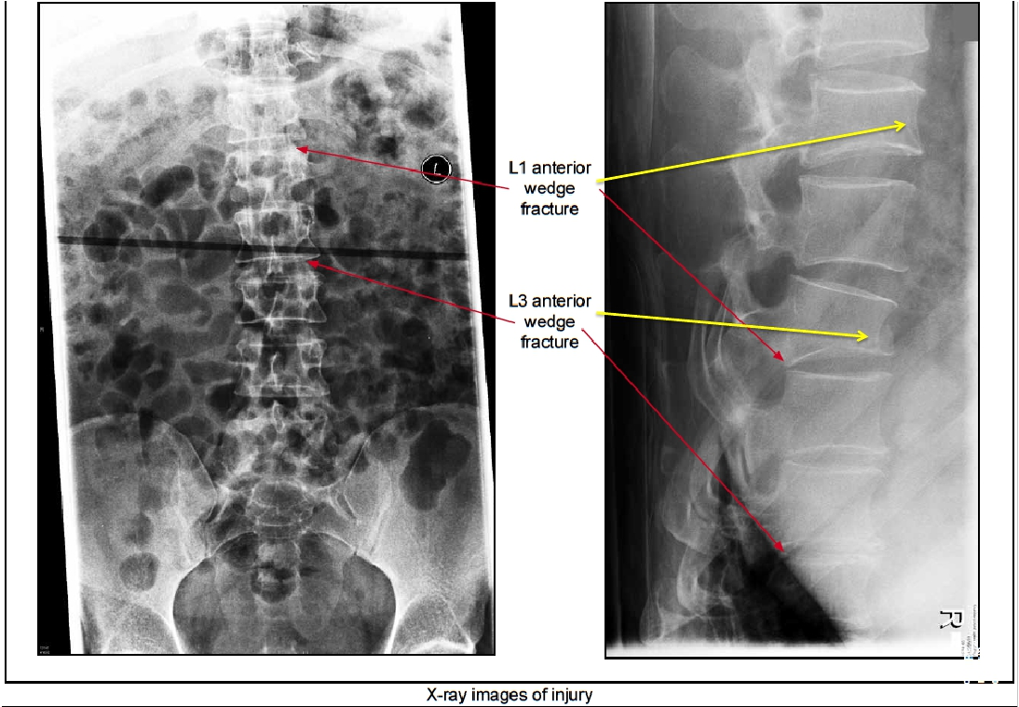



Slide 21
High-Speed Boats cause
dangerous impacts
EXPERIMENT
Standing is not good!
- Standing up increases impact
Sitting is not good!
- Sitting down increases impact forces on
your spine

Slide 22
How to avoid dangerous impacts
Why is sitting normally, bad?
• Sitting normally puts your spine in C-shape
– the worst position for impact
• Sitting normally puts your body weight behind your feet
- where you can not support it by muscular force.
• Sitting normally puts your head in front of the body.

Slide 23
Experiment: !
1. SitEXPERIMENT
on your chair!
2. Lift your rear end, just 5cm off seat – Hold for 20 sec!
3. Imagine impact of 7g! = 7 times your own weight in this position.
• Sitting normally puts your spine in C-shape
–the worst position for impact
• Sitting puts your body weight behind your feet,
- where you can not support it by muscular force.
• Sitting puts your head in front of the body.

Slide 24
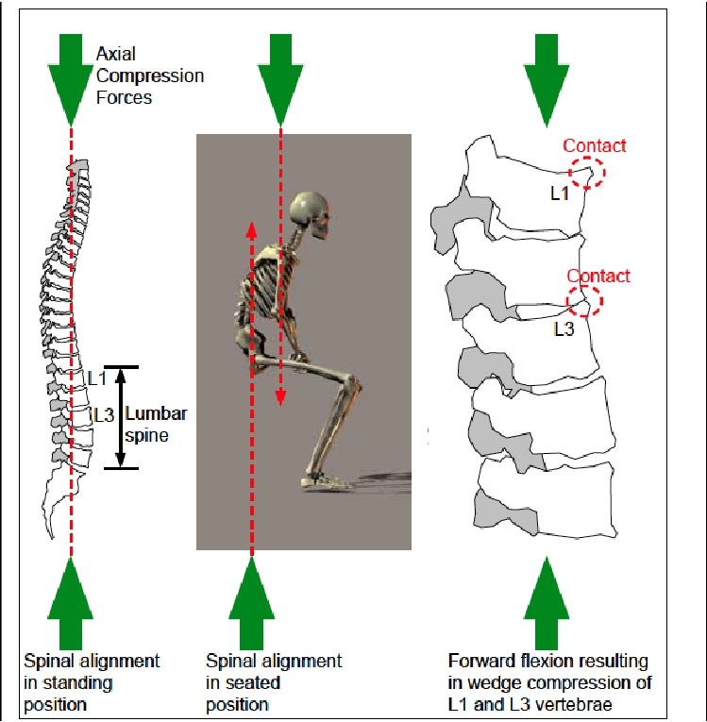

Slide 25
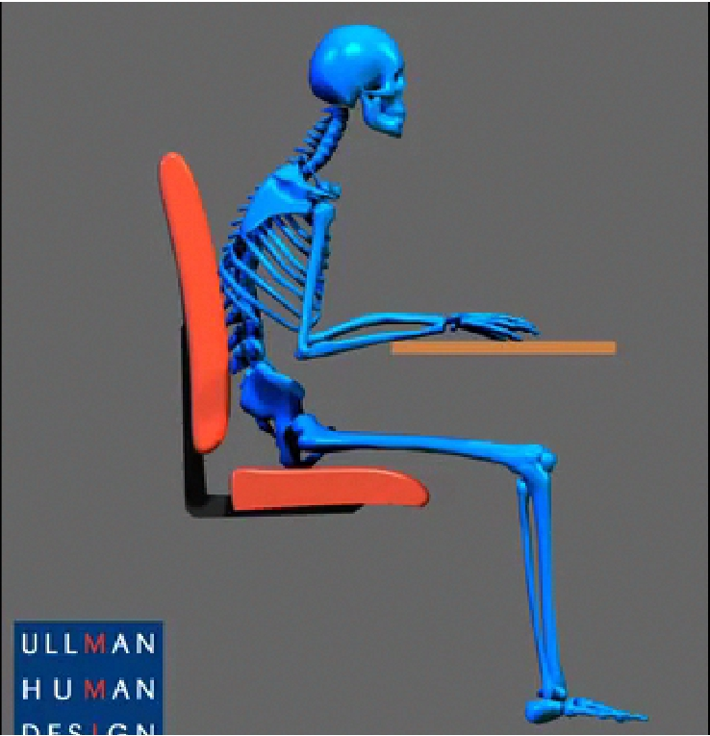

Slide 26
Carlsson!

Slide 27
Bottoming out is dangerous
A suspension seat bottoming out
( = stopping abruptly at end of stroke)
can multiply deck impact buy > 3 times
A hull impact of 4g can
expose a human to 14g.

Slide 28
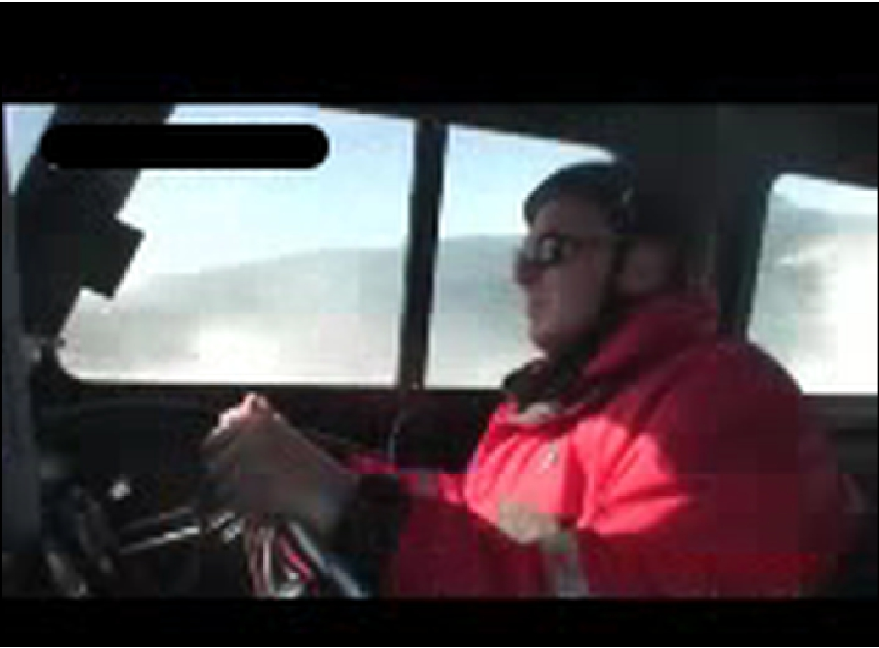

Slide 29
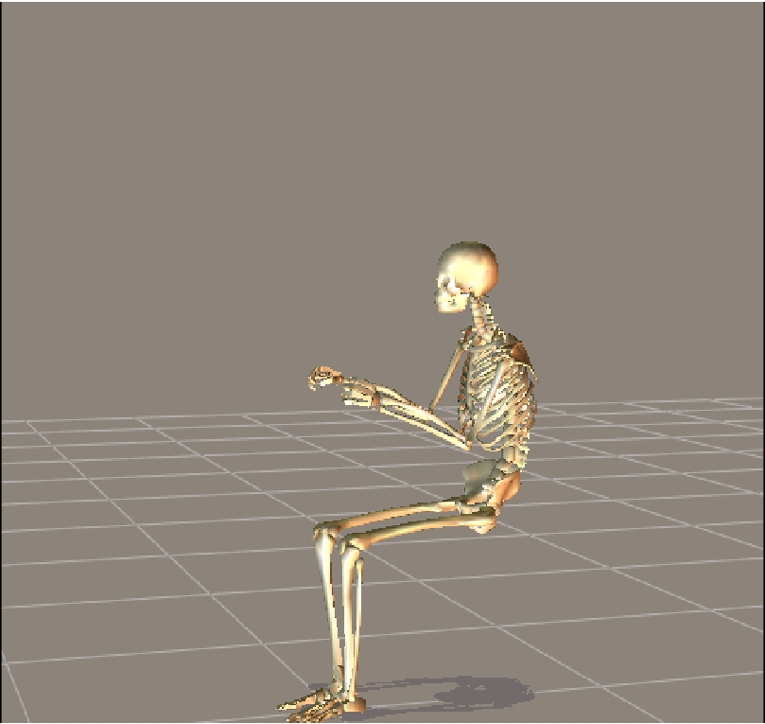

Slide 30
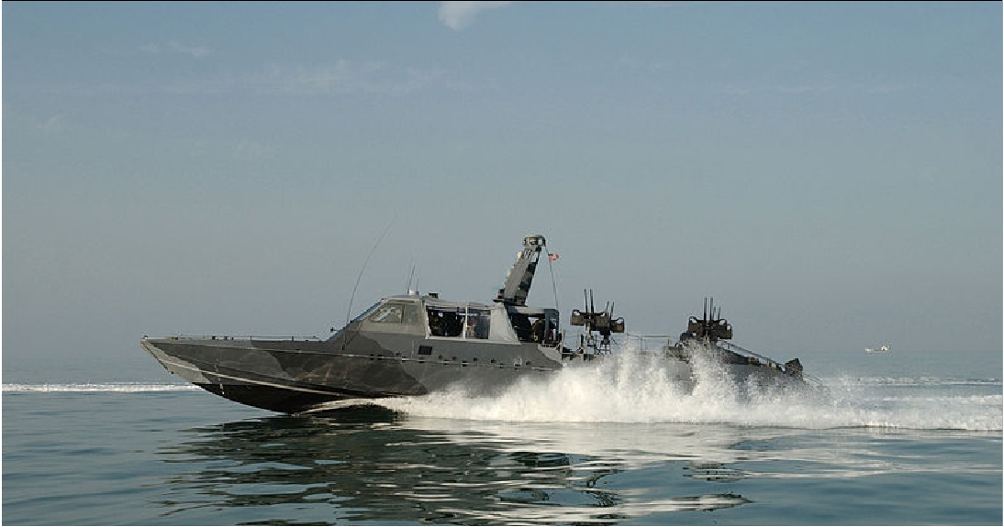
!
US Navy Mark V

Slide 31
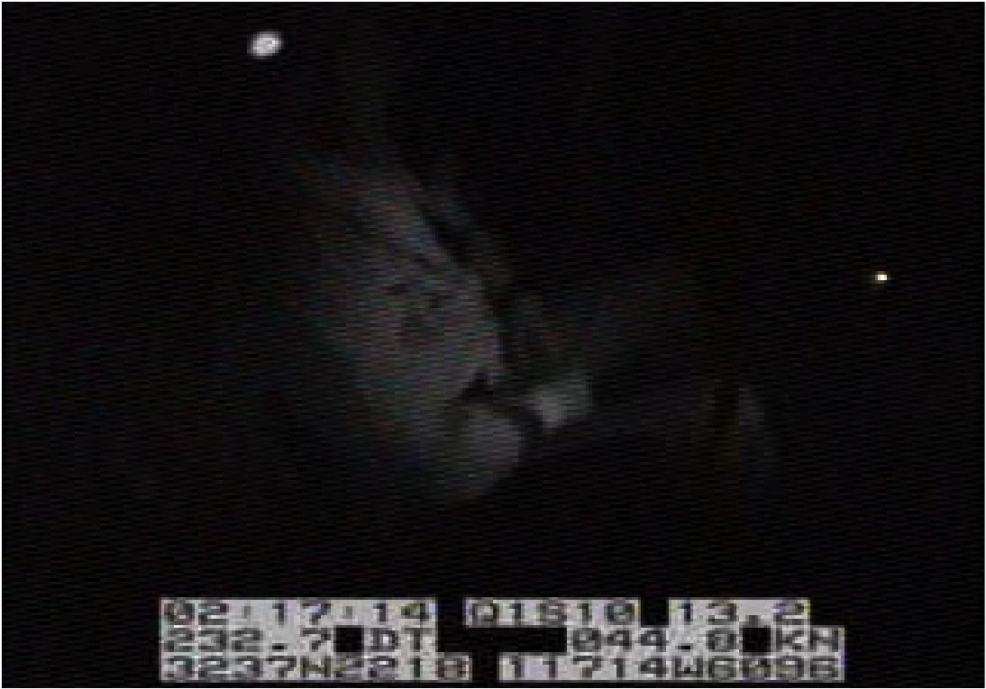

Slide 32
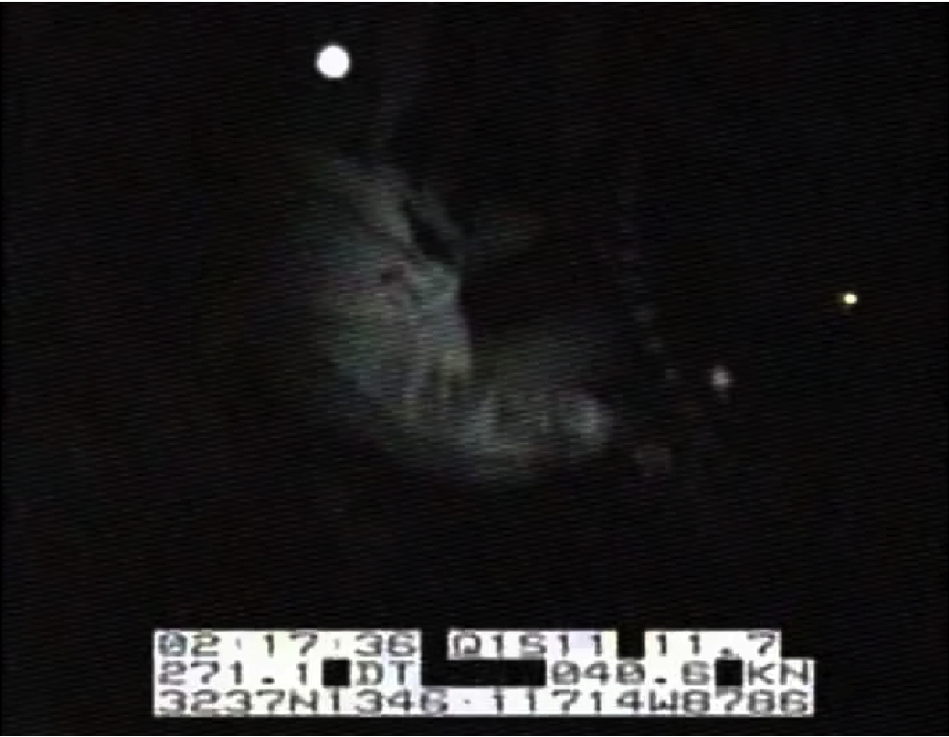

Slide 33
Bottoming out is dangerous!
Suspension seats bottoming out can
multiply the impact on the human by
more than 3 times
A 4g impact on the hull
can be a 14g impact on the human !

Slide 34
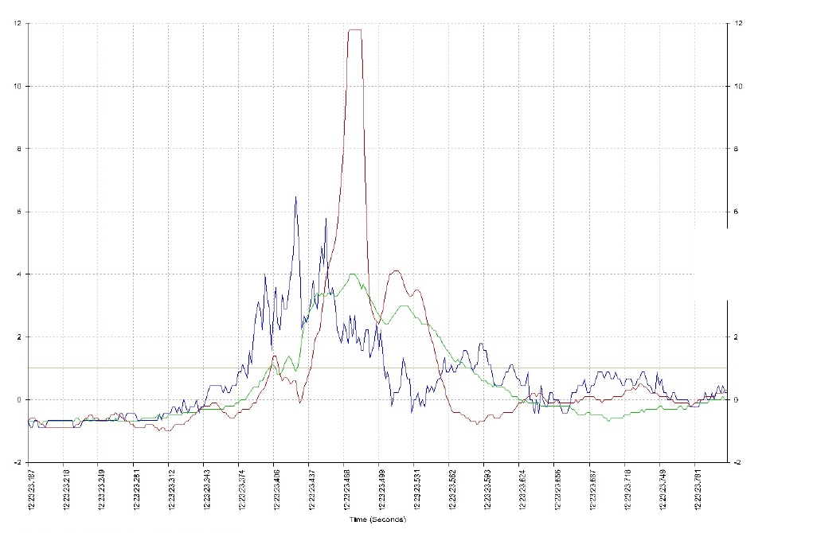
Impact levels on hull and on two different suspension seats showing !
one seat bottom out and multiplying impacts to over 12 g hull impacts.!
Limit for accelerometer was 11.5 - Extrapolation indicates impact peak is 14 -15g!
!
Blue – Hull/Deck!
Green – Seat B!
Red – SeatA !

Slide 35
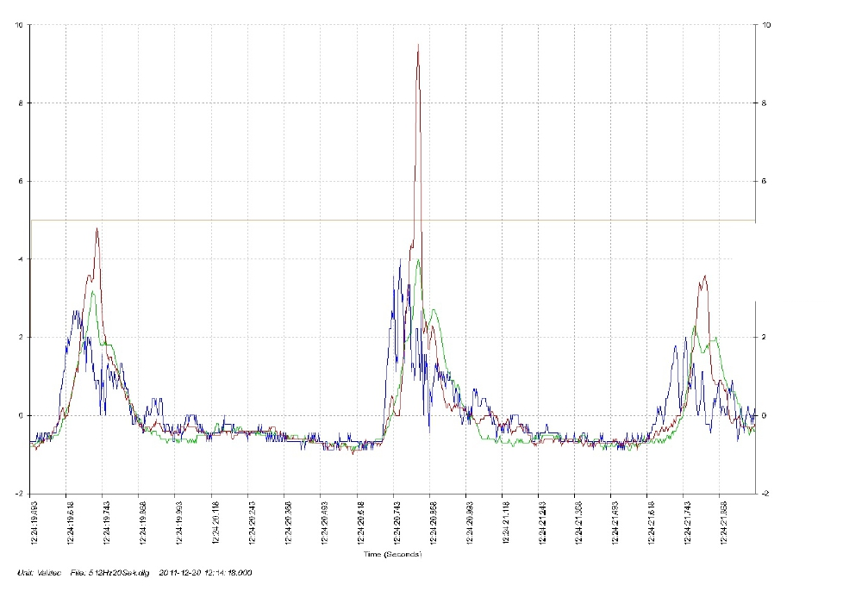
Blue – Hull/Deck!
Green – Seat B!
Red – SeatA !
Impact levels on hull and on two different suspension seats showing !
one seat bottom out and multiplying impacts already at 2 g hull impacts.!

Slide 36
!
Results'('Human'impact'exposure'
• Seat'A'repeatedly'multiplied*exposure*on'human'
to'over'3*times*higher*than'deck/hull'impacts'
• Seat'A'showed'maximum'peak'values'of'11.8g''
'(max'value'for'Valitec/Crossbow'device*)'
• Seat'B'showed'maximum'peak'value'of'4.3g*
*on'Valitec/Crossbow''
• Seat'B'reduced*exposure*on'human' '
'–'More'reduction'the'higher'the'impacts.''
*
'

Slide 37
Why Standing up is Bad?!

Slide 38
Why Standing up is Bad?!
Standing up can multiply the
impact on the human - !
!up to 3 times !
Several studies have shown this!

Slide 39
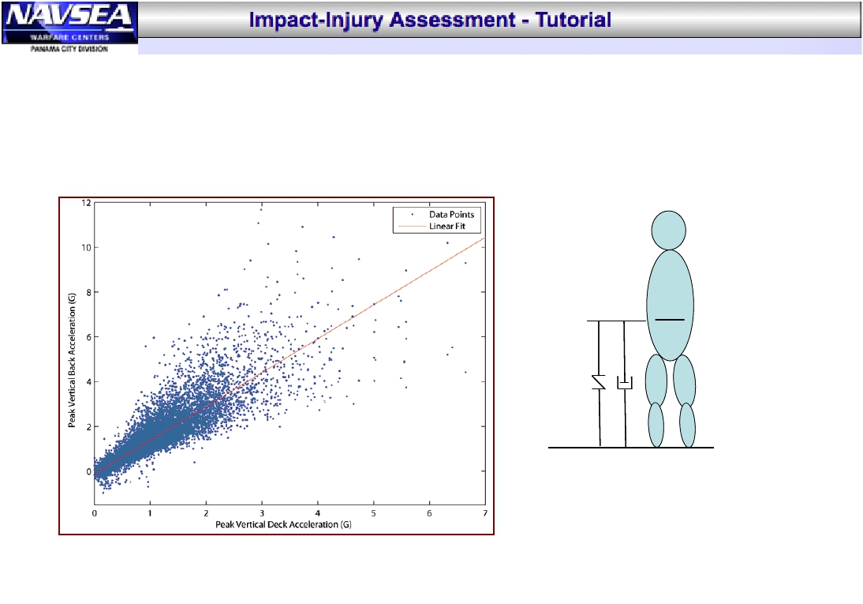
Transfer Functions (cont)!
Deck-to-L4 Standing Transfer Function!
L4
Deck-to-L4 Back TF
(Standing Model)
Deck
1:1 relationship!
•
Created using deck and back data from NSW RIB!
!sea tests!
Created using deck and back data from NSW RIB sea tests!
•

Slide 40
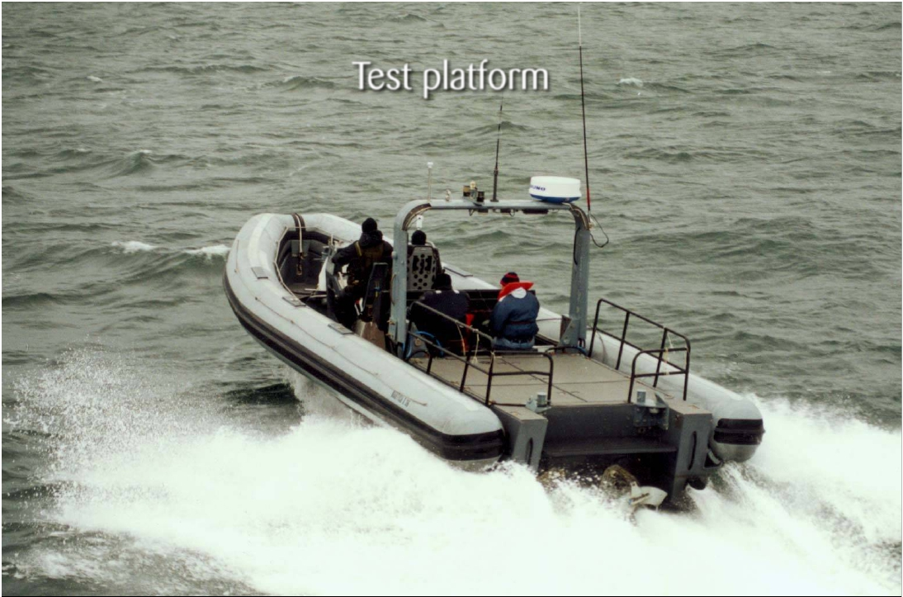

Test platform
36-foot Nautica RIB 2x 350hp water jet.

Slide 41
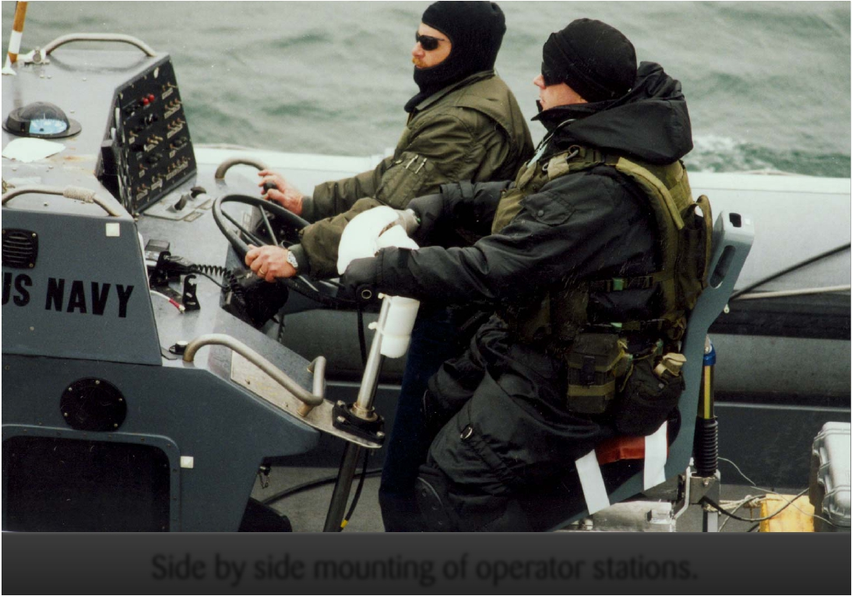
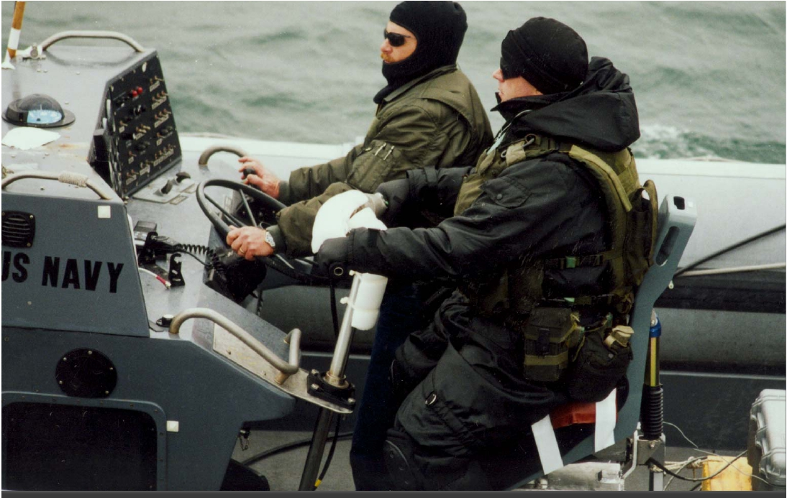
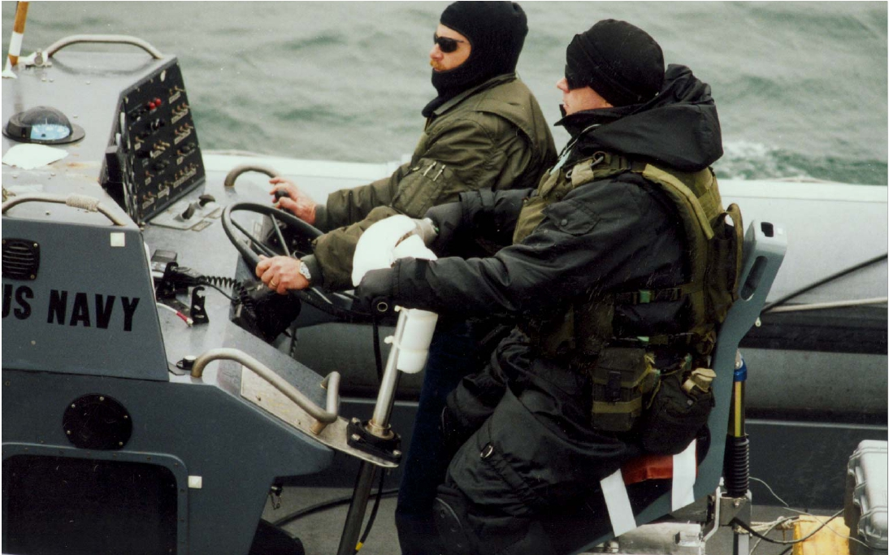

Side by side mounting of operator stations.

Slide 42
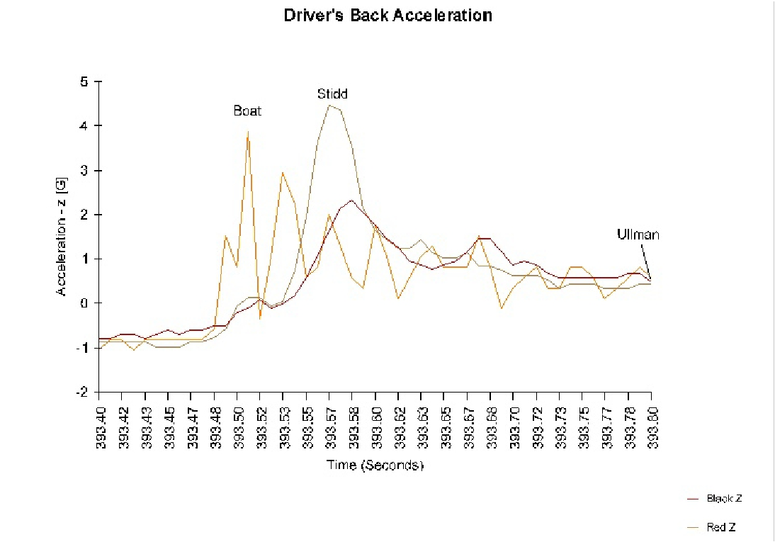

Slide 43
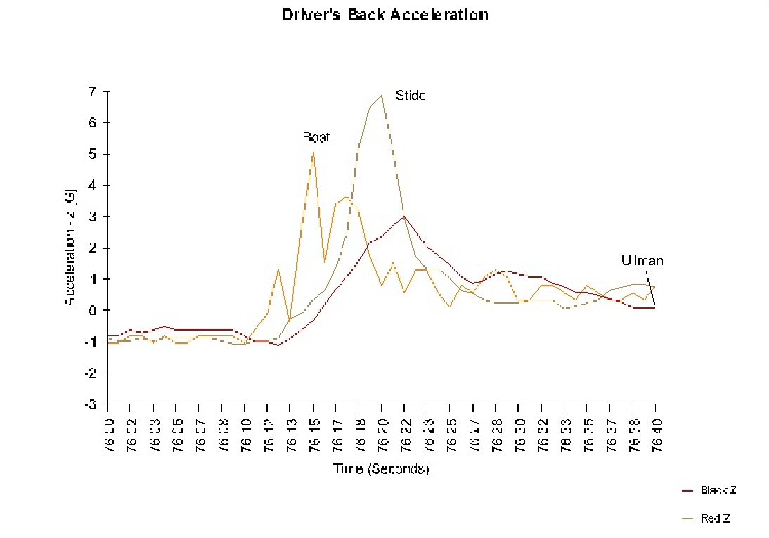

Note the standing operator
receiving an amplified impact
- greater than the boat hull s.

Slide 44
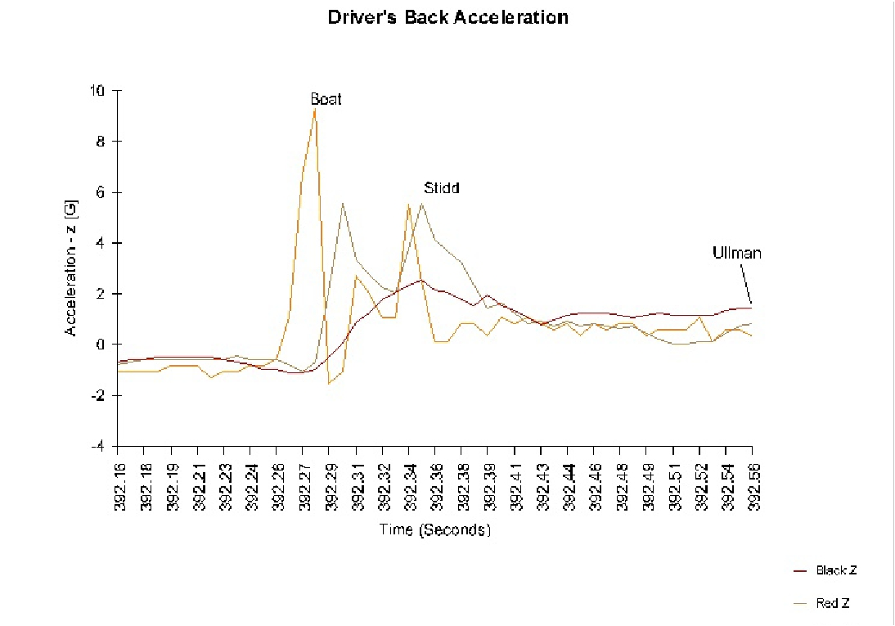

Slide 45
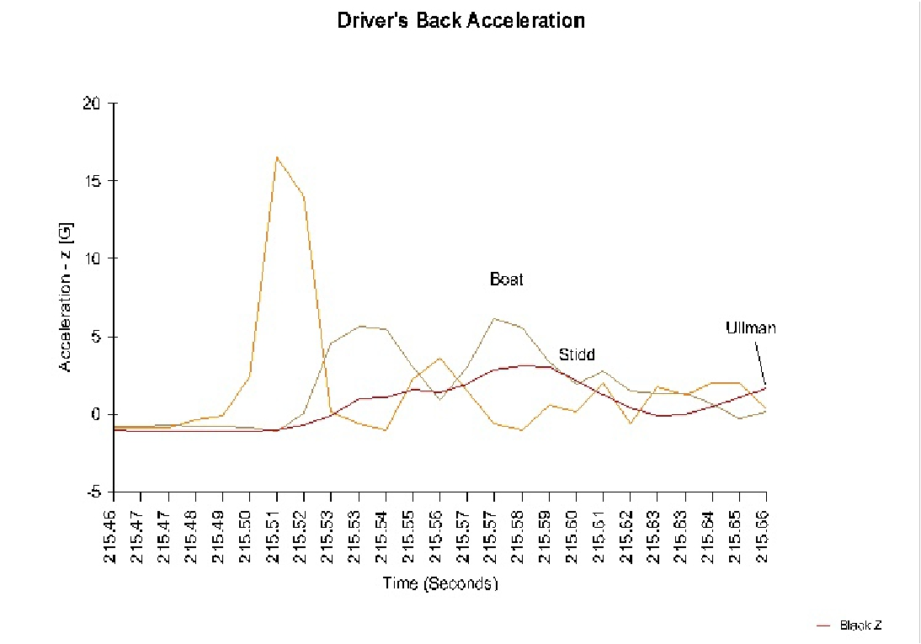

Note the 180˚ phase shift between the boat
and the standing operator
in the traditional seat.

Slide 46
Mean impact on drivers backs for
all hits over 3 g and all over 4g
Threshold | Nhits | Impactondriversback |  |  | Difference [%]
 |  | Ullman | Stidd | Difference
3g | 52 | 2.9g | 4.0g | 1.1g | 37%
4g | 22 | 3.3g | 5.0g | 1.7g | 52%
Higher impacts give larger differences

Slide 47
How can a standing
person
get higher impacts
than the boat itself ?
YES!

Slide 48
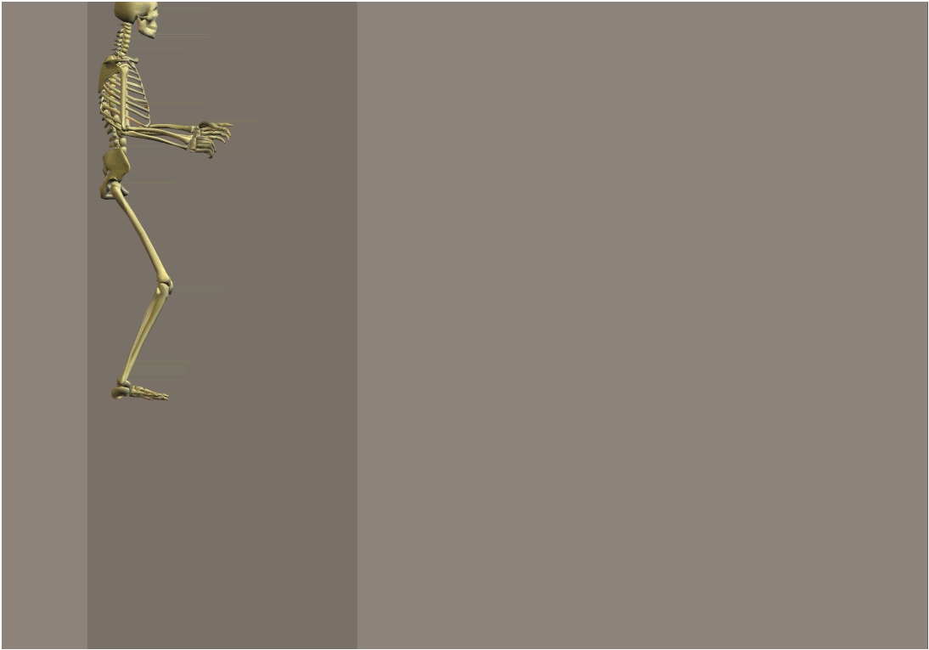
Standing with
slightly bent legs
Boat goes airborne
Boat and human
in free fall
Leg muscle tension
stretches legs
Legs almost straight
at impact
Knee flex - too late!

Slide 49
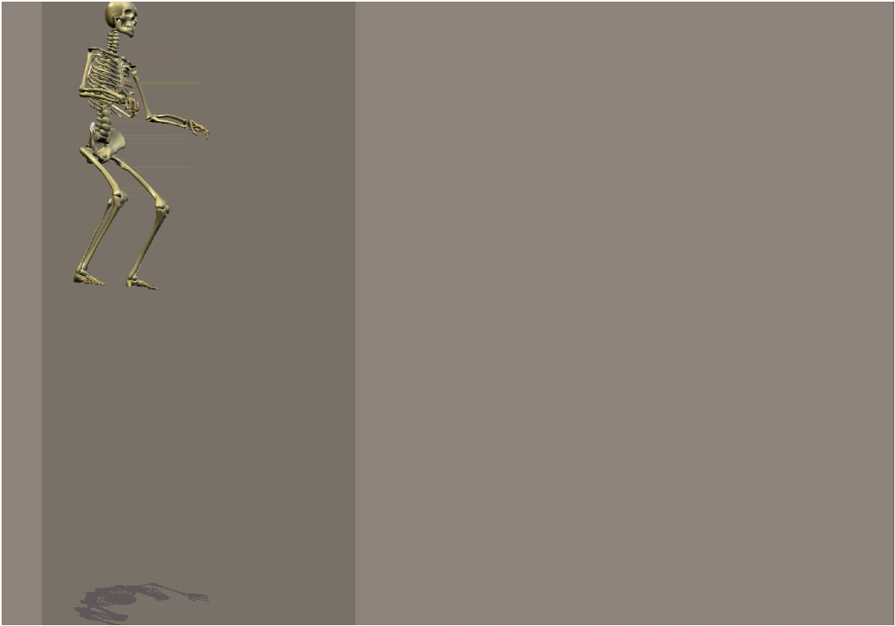
Straddle-seated with bent legs
Boat and human in free fall
Balance with C.O.G. over feet
Legs and arms bent at impact
Impact releases reflex response
Legs, arms and suspension
synergize

Slide 50
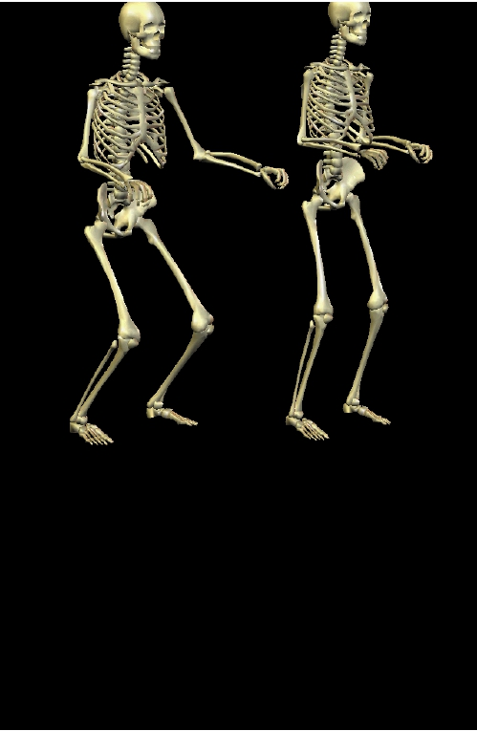

Slide 51
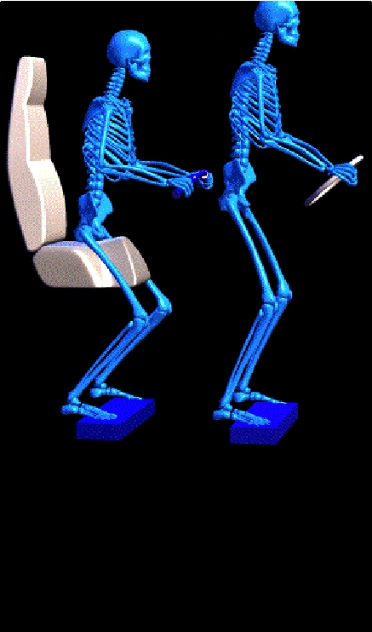

Slide 52
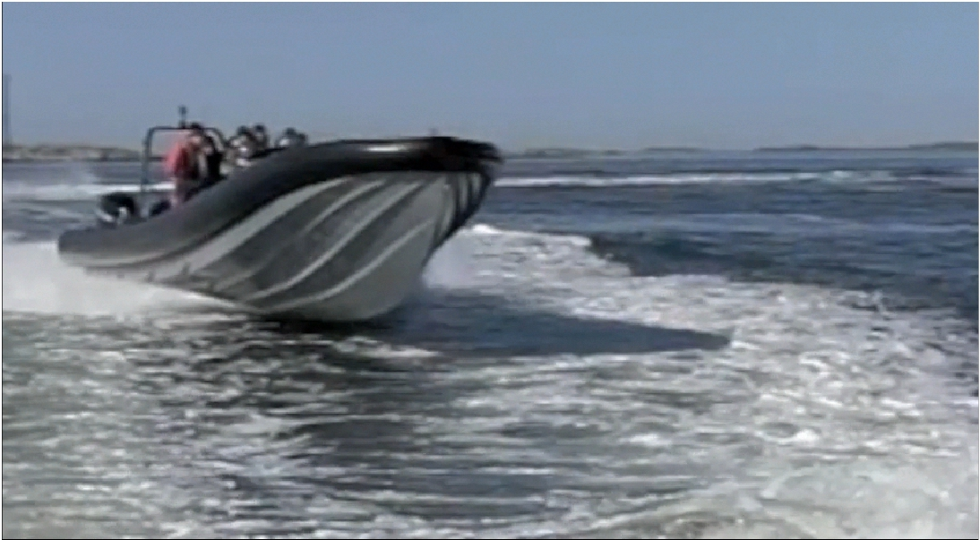
SeaBlade!

Slide 53


Slide 54


Slide 55


Slide 56
Muscular reflexes protect the body at impact
Muscles in all the body react adequately
Both legs and arms need to absorb impacts
C-shaped posture of Spine and
- Balance of Head are Crucial
Feet in contact with deck necessary
to trigger muscular reflexes at impact

Slide 57
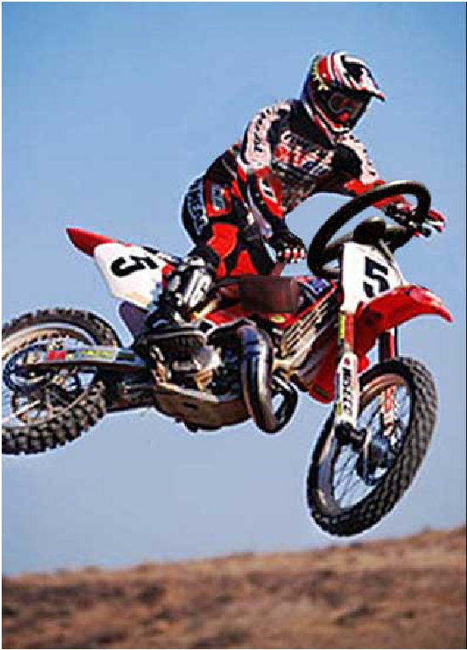
For full control of vessel,
Both hands and both
feet are needed!
Needed for tactile
feedback
Needed for shock
control and for
posture control

Slide 58
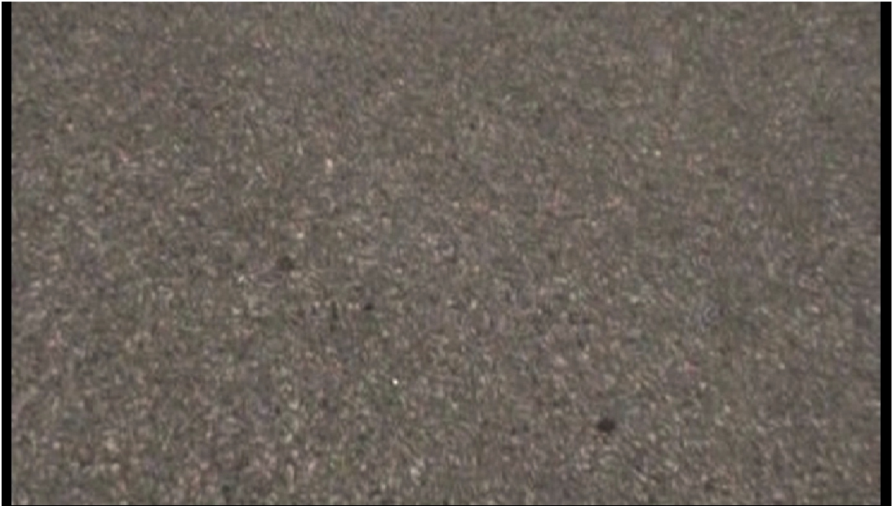
This illustrates in slow-motion how legs
and arms take up impacts by reﬂex action!

Slide 59
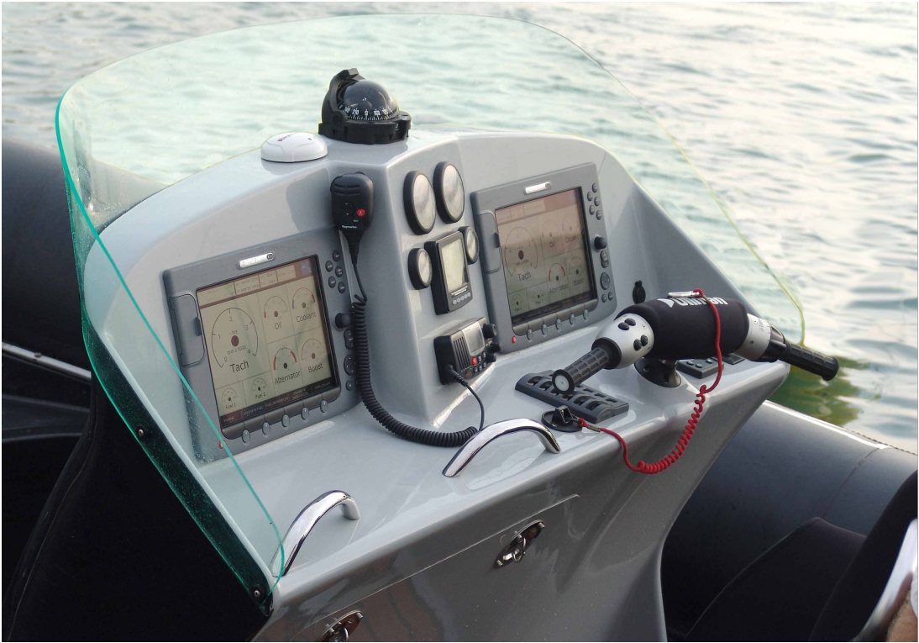

Slide 60
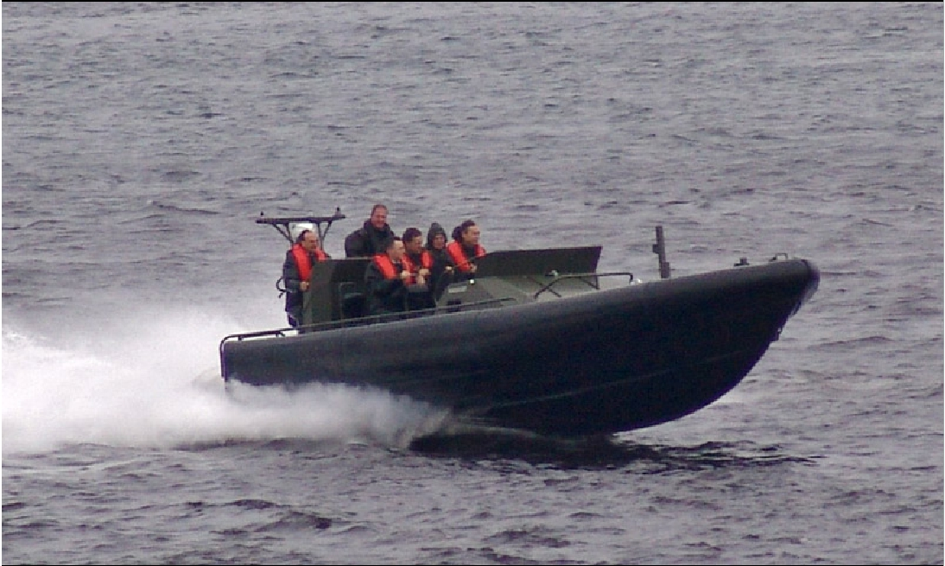

Slide 61
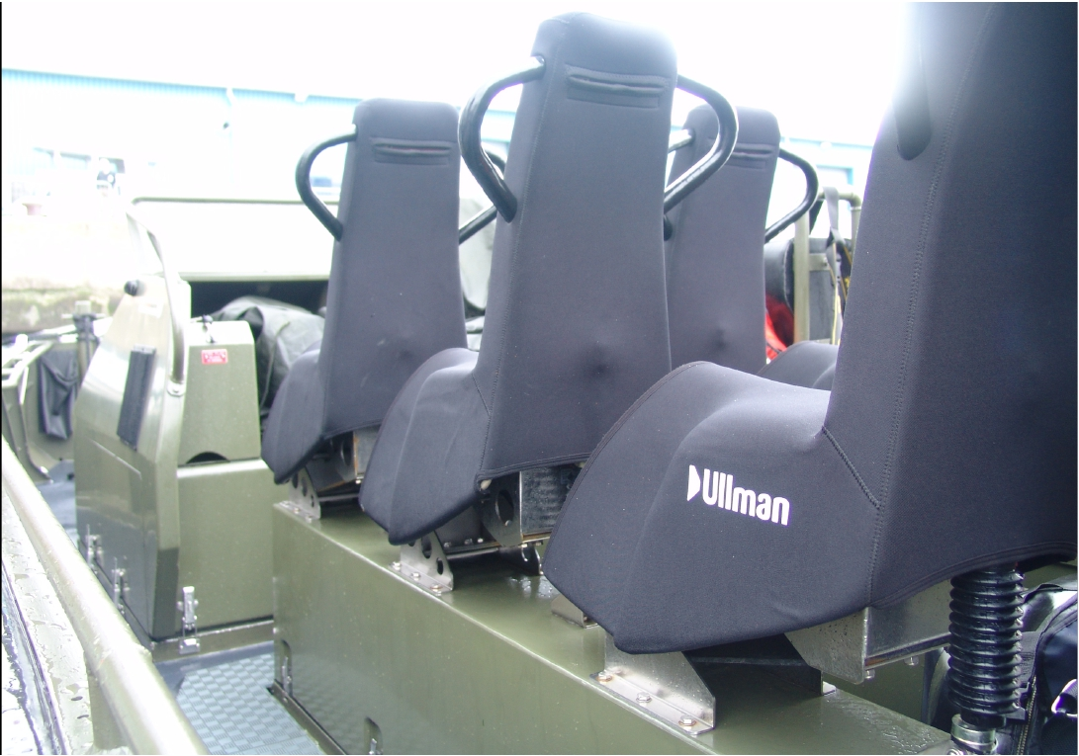

Slide 62
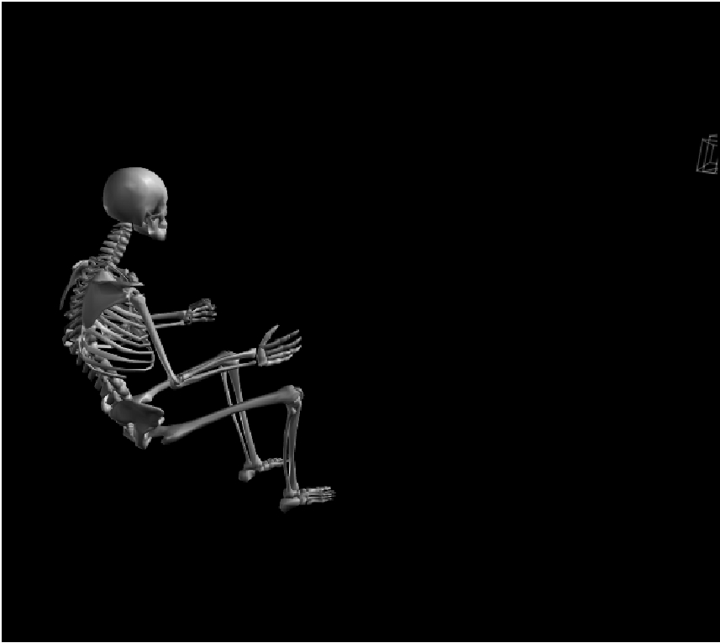
Lateral Support
- Good or Bad?
Seated -
Low side support
Seated –
High side support
Lateral support
Just by straddle

Slide 63
Height Adjustment?
Should short people sit lower?
- or should tall people sit lower?
Seated eye height differs very little
between tall and short people.
Sight lines are Crucial
Any height-adjustability - if needed -
should be for the feet

Slide 64
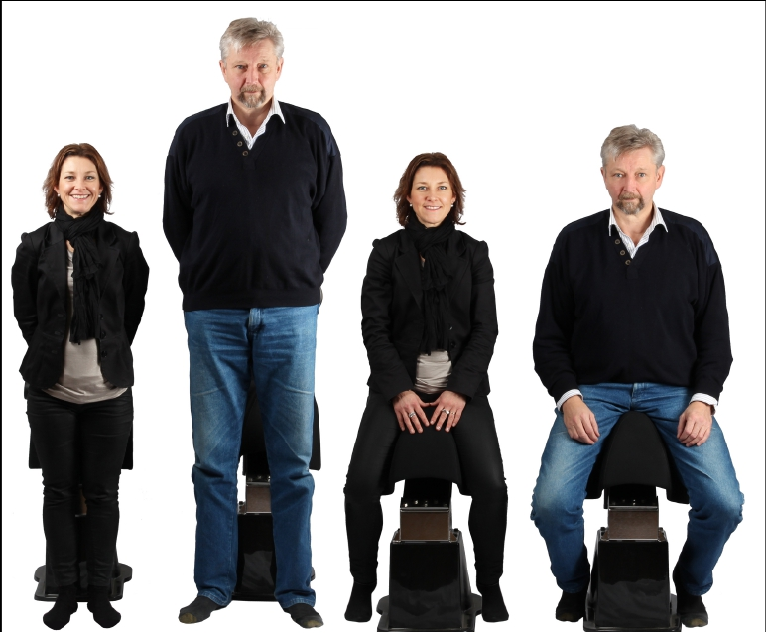
Height Adjustment?

Slide 65
Longitudinal Adjustment?
When seated in straddle position there is
No need for adjusting position of seat
Good position of arms is important
When seated in a reclined position
longitudinal adjustment can be useful
- for the helm seat

Slide 66
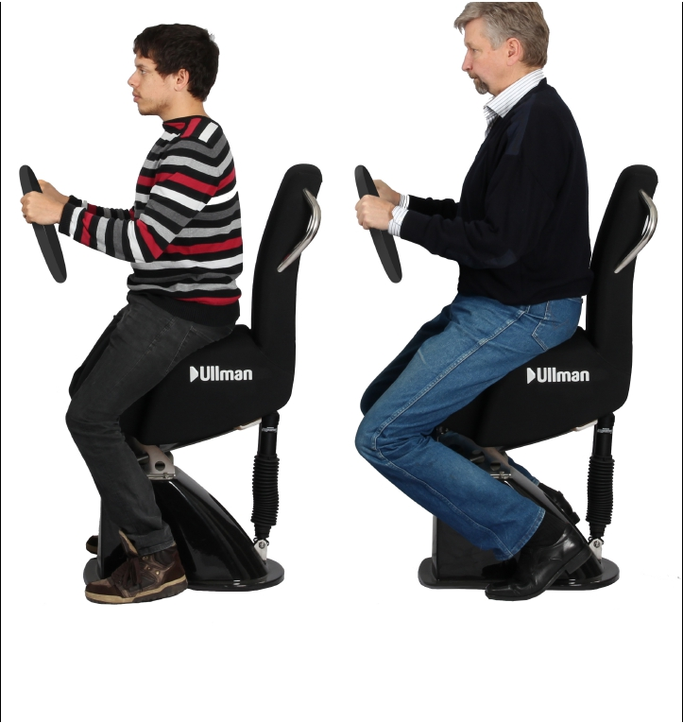
Longitudinal Adjustment?

Slide 67
Conclusions!
Exposure and risks increase with speed
Fatigue limits operations
Seats bottoming out multiply impact
Standing can multiply impact up to 3 times.
Suspension must synergize with the human reflex
based protection system
Posture must be optimised
for balance - S-shape not C- Shape !
for reflexes - legs where they can support
Technologies validated scientifically - and at sea
Helmsman and crew training still crucial for safety

Slide 68
Thank you !

Slide 69
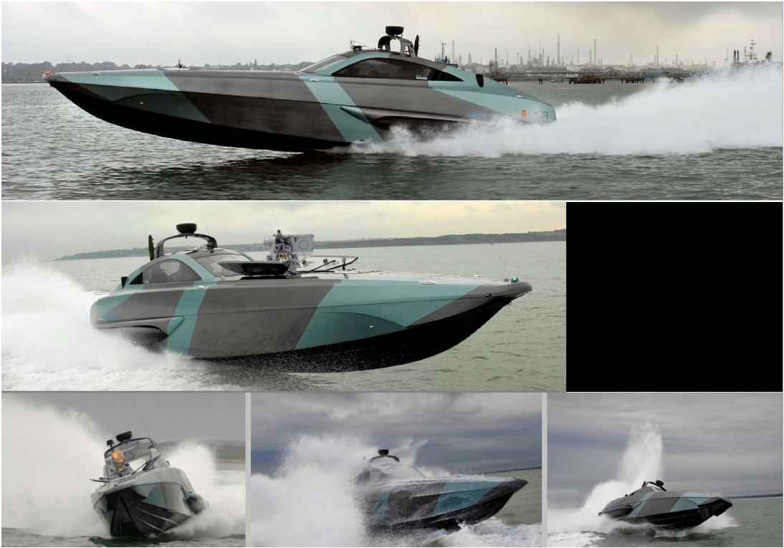
The XSR48 !
Top speed over 90 kts !
!
4 -6 UllmanAtlantic !

Slide 70
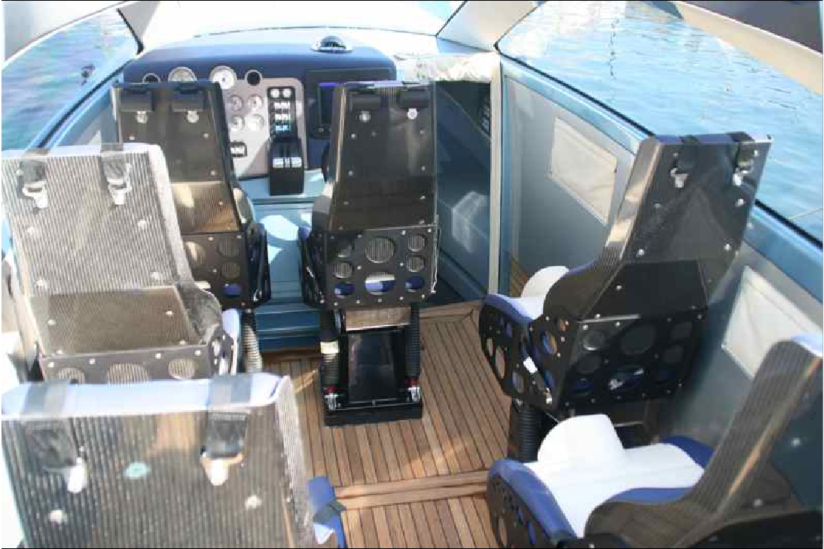

Slide 71
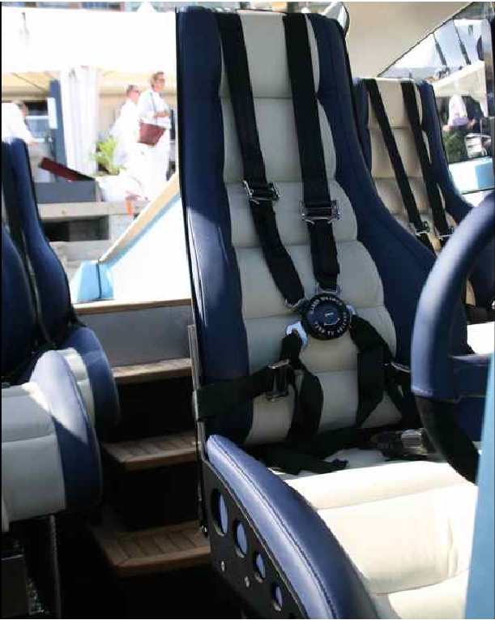

Slide 72
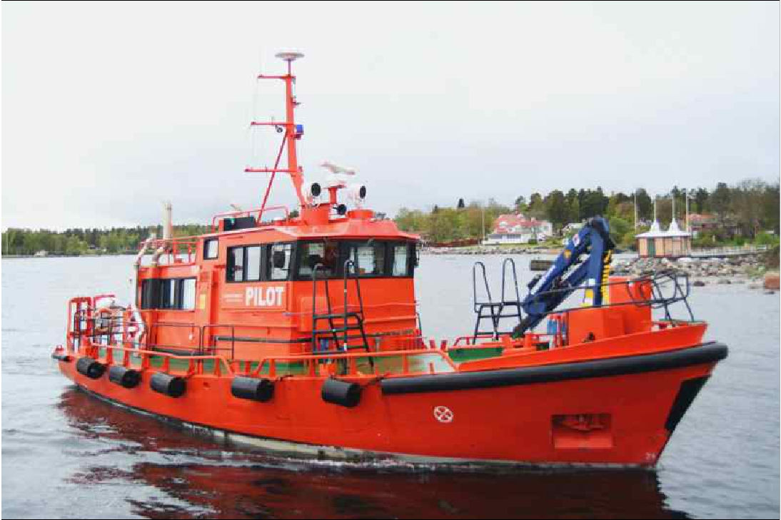

Slide 73
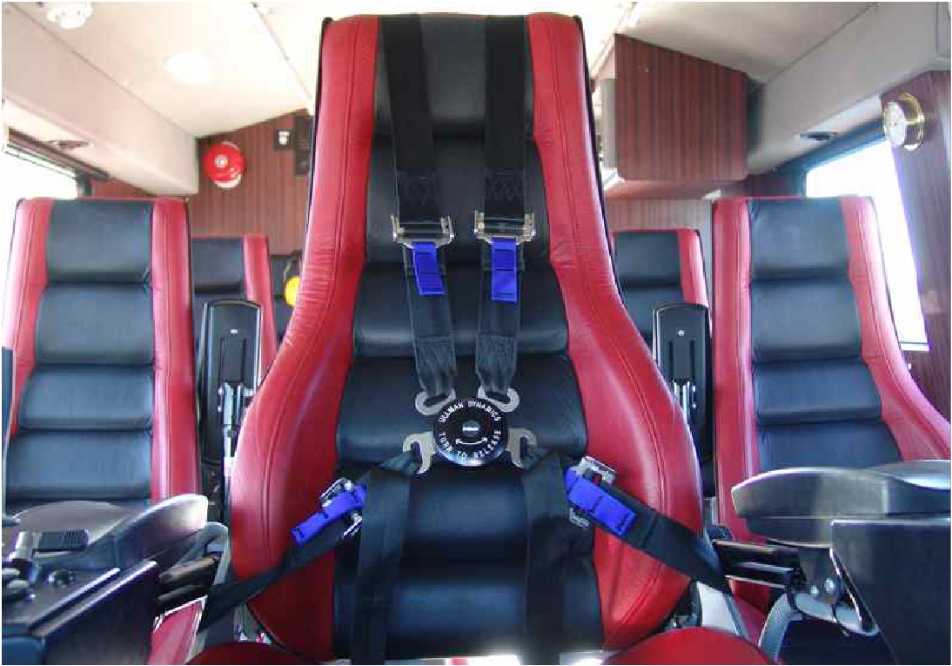

Slide 74
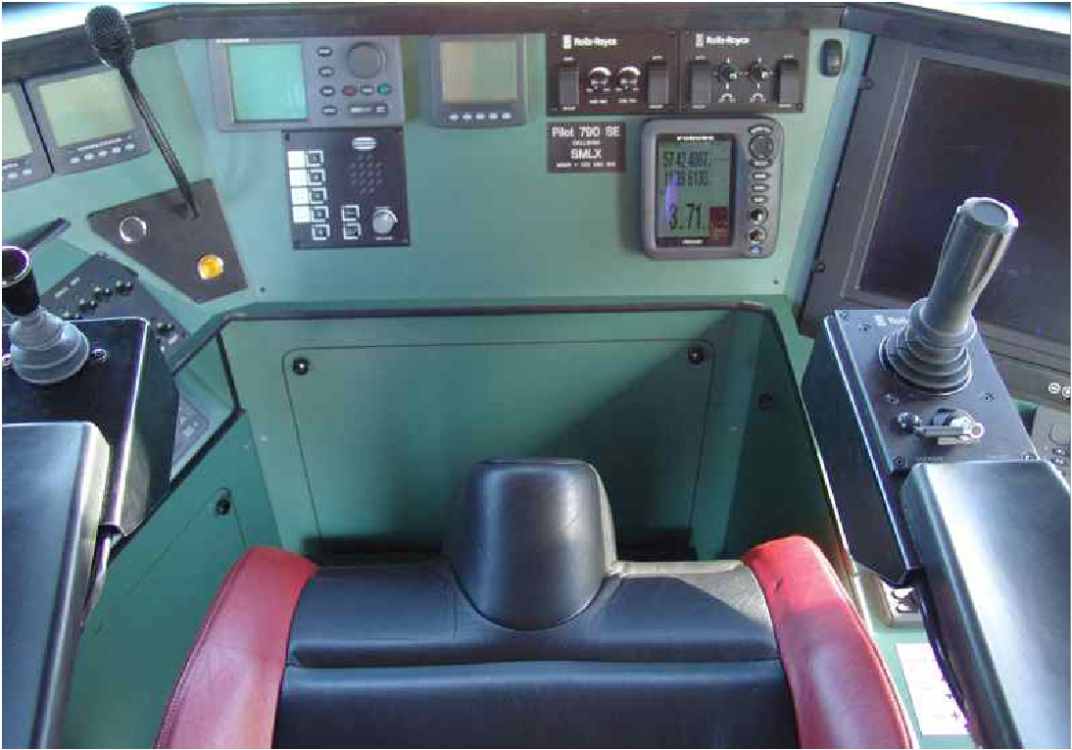

Slide 75
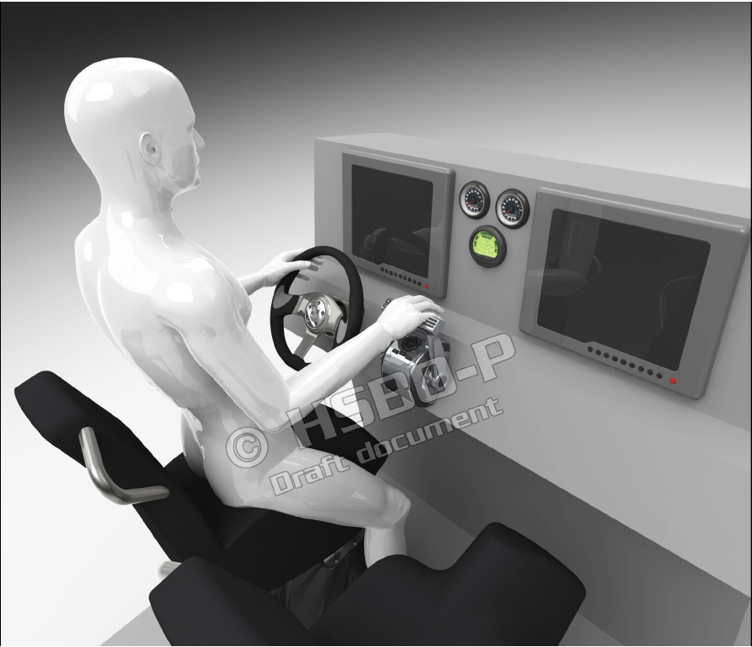

Slide 77
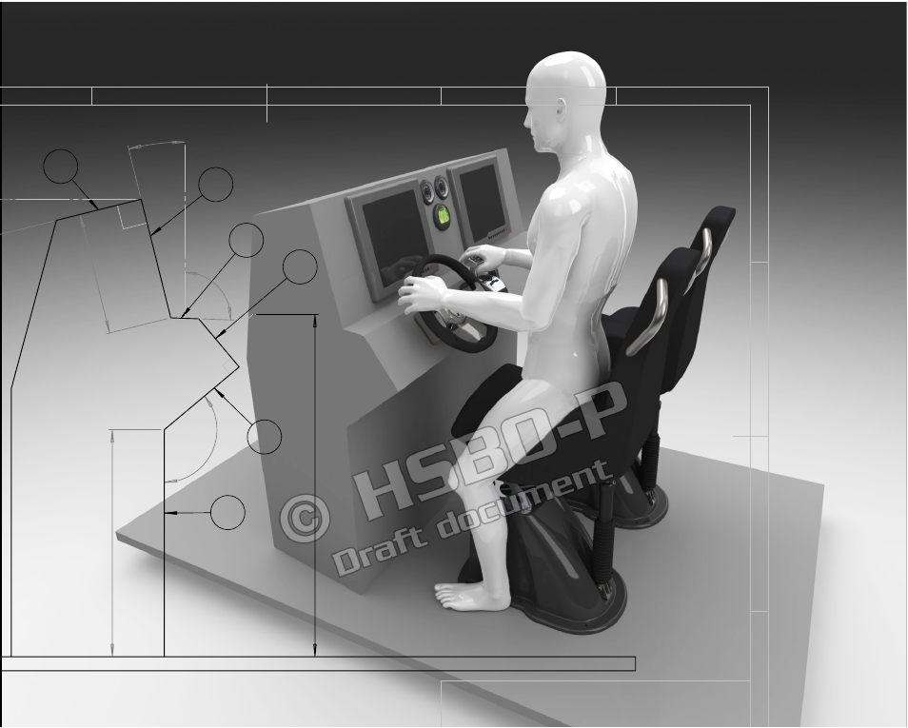



Slide 78


Slide 79


Slide 80


Slide 81




Slide 82


Slide 83


Slide 84


Slide 85


Slide 86


Slide 87



DAccR (DyenaAccelaration Recorder) !
Plots the track with coordinates and impacts values.!

Slide 88

Two DAaaRs used to show speed and
impacts on hull and driver!

Slide 89

Some of the world’s most experienced experts on the design,speciﬁcation,!
acquisition and professional use of High-Speed boats !
have come together to support those who need professional advice.!
Improving Safety and Performance - Reducing Risk and Cost!
!
www.HSBOPro.com!

Slide 90

Professionals in High-Speed Boat Acquisition
!
We support organisations worldwide planning to procure and operate high-speed boats!
!
Improving Safety and Performance - Reducing Risk and Cost!
!
www.HSBOPro.com!

Slide 91
High-Speed Boat Operation Training
!
Training theTrainer – Boat handling in Challenging Conditions – HS Navigation!
!
Improving Safety and Performance - Reducing Risk and Cost!
!
www.HSBOPro.com!

Slide 92


Slide 93

Fixed foot rests for UllmanAtlantic orArctic seats!

Slide 94


Slide 95


Slide 96


Slide 97

Ullman Dynamics
Protecting People

Slide 98
Questions!

